Slide 1
Venture capital contracts
… ‘value’ and ‘investment’

Slide 2
Balance sheet structure
Tata Steel Ltd. - Balance sheet as on March 31 2012
SOURCES OF FUNDS : |  |  | APPLICATION OF FUNDS :
Share Capital | 971.41 |  | Gross Block | 23,485.63
Reserves Total | 51,649.95 |  | Less : Accumulated Depreciation | 11,986.17
Equity Share Warrants | 0 |  | Less:Impairment of Assets | 133.2
Equity Application Money | 0.17 |  | Net Block |  | 11,366.26
Total Shareholders Funds |  | 52,621.53 | Lease Adjustment |  | 0
Secured Loans | 1,915.47 |  | Capital Work in Progress |  | 16,058.49
Unsecured Loans | 19,437.73 |  | Investments |  | 50,282.52
Total Debt |  | 21,353.20 | Inventories |  | 4,858.99
Current Liabilities |  | 14,837.23 | Sundry Debtors |  | 904.08
Provisions |  | 2,066.24 | Cash and Bank |  | 3,946.99
Deferred Tax Liability |  | 1,987.78 | Loans and Advances |  | 1,950.27
Other Liabilities |  | 4,342.35 | Miscellaneous Expenses not written off |  | 0
 |  |  | Deferred Tax Assets |  | 1,017.27
 |  |  | Other Assets |  | 6,823.46
Total Liabilities |  | 97,208.33 | Total Assets |  | 97,208.33

Slide 3
Income statement structure
Expenses |  |  | INCOME
Raw Materials | 8,223.89 |  | Sales Turnover | 37,005.71
Power & Fuel Cost | 1,990.16 |  | Excise Duty | 3,072.25
Employee Cost | 3,047.26 |  | Net Sales |  | 33,933.46
Other Manufacturing Expenses | 4,460.35 |  | Other Income | 1,397.44
Selling and Administration Expenses | 3,240.10 |  | Stock Adjustments | 220.72
Miscellaneous Expenses | 2,133.88 |  | Total Income |  | 35,551.62
Depreciation | 1,151.44
Less: Pre-operative Expenses Capitalised | 478.23
Total Expenditure |  | 23,768.85
Operating Profit (EBIT) |  | 11,782.77
Interest | 1,925.42
Profit Before Tax |  | 9,857.35
Tax | 3,115.11
Fringe Benefit tax | 0
Deferred Tax | 45.82
Reported Net Profit (Profit After Tax) |  | 6,696.42

Slide 4
Concepts of value
Book value of assets and equity
Value as shown in the balance sheet; usually functions as the base value
Market value
Value as determined by an ‘efficient’ market
Usually the ‘market capitalisation’ of listed firms
Replacement value
Value of assets if it is to be replaced in the market now…!
Book value of a car vs. market price of a similar car in the secondary market
Prices of similar assets
Many times used as a substitute for the value of asset itself…

Slide 5
Concepts of value
Premium / discount associated with ‘value’
If competition for the asset is high, a premium is paid
For ex.: prime land in the heart of the city
If asset degradation is beyond the usual expected depreciation, discount is applied
A dilapidated building, though used for some non-living purposes
Value may be different for different parties looking at the same asset
Such differentiators are collectively called ‘synergy’…

Slide 6
Valuation methods – Comparables
Market capitalization as ‘firm value’
Based on the all inclusive assumption: “Markets are efficient”
Hence, an appropriate market price based ratio of comparable compan(y)(ies) will be considered as bench mark
But the comparable company need to be comparable in most aspects
To put it simply:
Identify a similar company that have public market data
Match the Co.X to that similar company and arrive at the value

Slide 7
Valuation methods – Comparables
Example:
Assume IIFL and Fintso have similar firm profile
IIFL is a listed company whereas, Fintso is unlisted and is being valued by PE investors for further funding round; here are the other information:
IIFL | Values | Fintso | Values
Earnings per share (EPS) | 3.72 | EPS | 5
Price per share (PPS) | 81.20 | PPS | x
Price Earnings ratio | (81.20 / 3.72) = 21.83 | Price Earnings Ratio | 21.83 (Same as comparable co.)
 |  | PPS (Calculated) | (x/5) = 21.83 So, x = 109.14
Notes:
Co.X: The company being valued

Slide 8
Valuation methods – Comparables
Other similar multiples
Category | Sub-groups
Earnings multiples | Price-to-earnings Price-to-EBIT Price-to-EBITDA
Book value or replacement value multiples | Price-to-book value Tobin’s Q (MV / Asset value)
Revenue multiples | Price-to-sales Value / sales

Slide 9
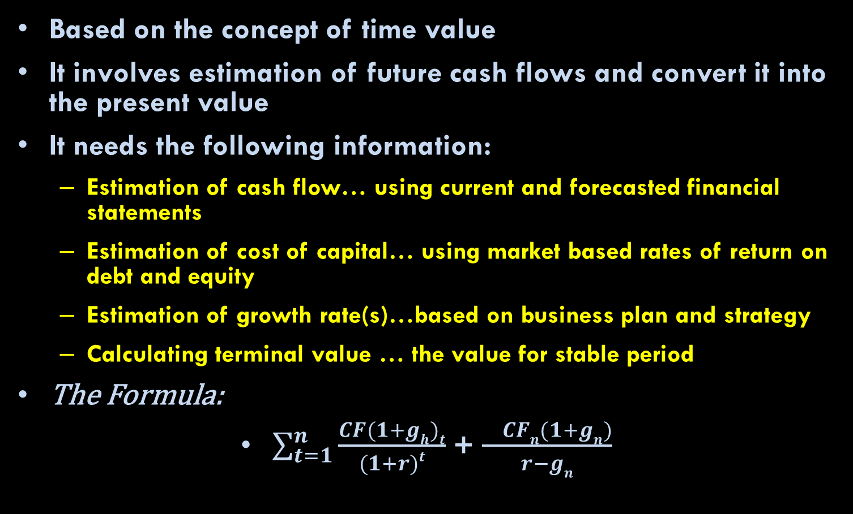
Valuation methods – Discounted cash flow
Based on the concept of time value
It involves estimation of future cash flows and convert it into the present value
It needs the following information:
Estimation of cash flow… using current and forecasted financial statements
Estimation of cost of capital… using market based rates of return on debt and equity
Estimation of growth rate(s)…based on business plan and strategy
Calculating terminal value … the value for stable period
The Formula:
$\sum_{t=1}^{n}{\frac{CF(1+gh)t}{(1+r)t}}$ + $\frac{ CFn(1+gn)}{r−gn}$

Slide 10
VC&PE specific valuation needs
Entry of later round investors and the anti-dilution issues
Start-ups require more funds during evolution stages, which an existing VC&PE couldn’t match up for various reasons
Anti-dilution issues arise during,
... down-rounds, in which the value of their original investment will be reduced
... up-rounds, when their actual stake is expected to come down
Intended Exit requirement of VC&PEs
VC&PEs are financial investors with a limited-life fund; they’ll have to exit after a specific time period
Investment returns for VC&PEs are generally estimated in advance, considering this ‘exit’ time period
Illiquidity and exit before IPO
IRR concerns

Slide 11
The venture capital method
The process
Calculate terminal value (starting from the expected positive cash flow year) using comparable / NPV / APV method
Use target capital structure as discount rate
Convert terminal value into present value using an arbitrary high discount rate
Applicable for firms with
Negative initial cash flows and
The potential value will be generated after few years
Useful for VC&PE firms to estimate their initial stake acquisition

Slide 12
A simple VC&PE valuation example
Pre-Money Post-Money conundrum in the context of VC&PE investment
‘Implied’ value of the business Based on the ‘expected / target return’ of the VC investor at the time of exit, say after 5 years
For example,
If the expected sales multiple after 5 years is 5 and the forecasted sales is Rs.30 lakhs, then the implied value @ year 5 is Rs.150 lakhs
If VC want to invest Rs.4 lakhs today and expects 50% return in 5 years, her expected value is Rs.30 lakhs (4x1.5⁵) approx.
Hence VC will have to acquire (30/150) 20% stake
In this case,
Post-money value is Rs.20 lakhs ((4/20)*100)
Pre-money value is Rs.16 lakhs (20-4).

